Slide 1
Overview
What are P-type and N-type semiconductors?
Intrinsic Semiconductors
Doped Semiconductors
N-type and P-type Semiconductors
Drift current
Diffusion Current
pn Junction

Slide 2
What are P-type and N-type ?
Semiconductors are classified into P-type and N-type semiconductor.
P-type: A P-type material is one in which holes are majority carriers i.e. they are positively charged materials (++++)
N-type: A N-type material is one in which electrons are majority carriers i.e. they are negatively charged materials (---)

Slide 3
Intrinsic Semiconductors
Intrinsic semiconductor : is one which is not doped. (Saf yarıiletken)
One example is pure silicon.
Generation –is the process of free electrons and holes being created.
Recombination –is the process of free electrons and holes disappearing.
In thermal equilibrium, generation and recombination rates are equal.(Isıl denge, enerji alışverişi yoktur. )

Slide 4
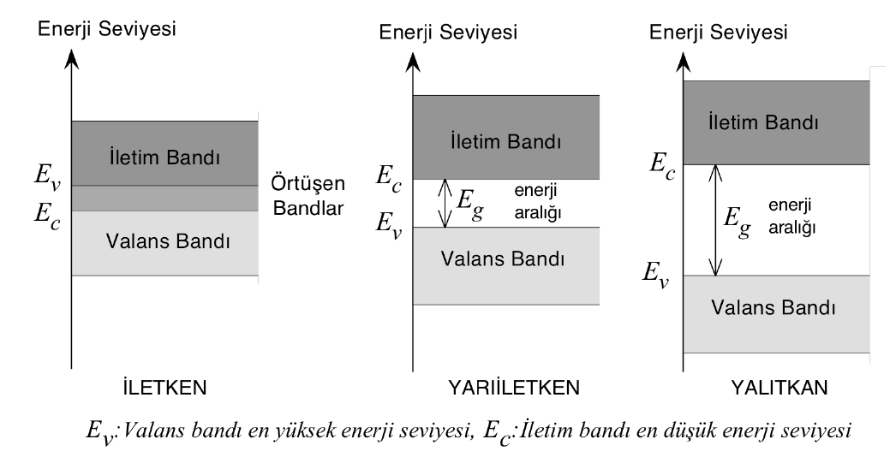
Conductors and Insulators

Slide 5
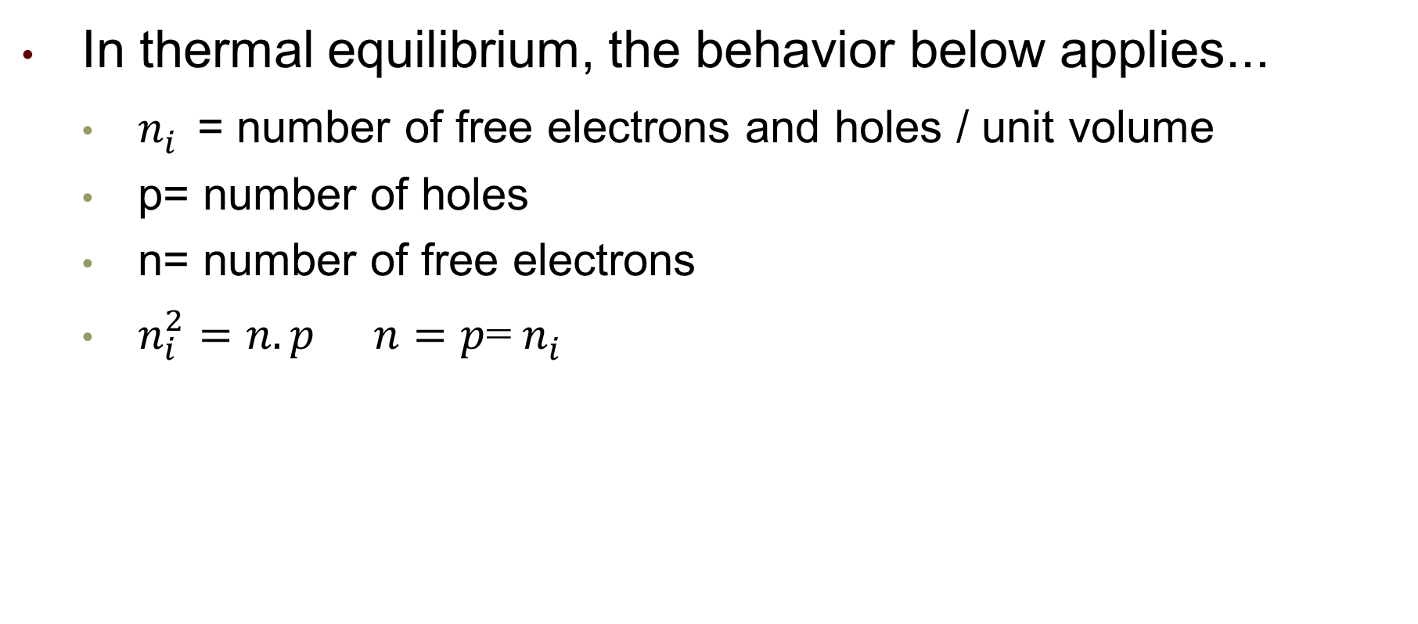
Intrinsic Smiconductors
In thermal equilibrium, the behavior below applies...
$n_{i}^{}$= number of free electrons and holes / unit volume
p= number of holes
n= number of free electrons
$n_{i}^{2}=n.p$ $n=p$=${ n}_{i}^{}$

Slide 6
Carrier Concentration
Intrinsic Semiconductors (Pure single-crystal material)
For an intrinsic semiconductor, the concentration of electrons (n_{i}) in the conduction band is equal to the concentration of holes (p_{i}) in the valence band.
n_{i} : intrinsic electron concentration
p_{i} : intrinsic hole concentration
SI
n_{i} = p_{i}
ni :intrinsic carrier concentration, which refers to either the intrinsic electron or hole concentration
SI
SI
SI
SI
SI
SI
SI
SI
SI

Slide 7
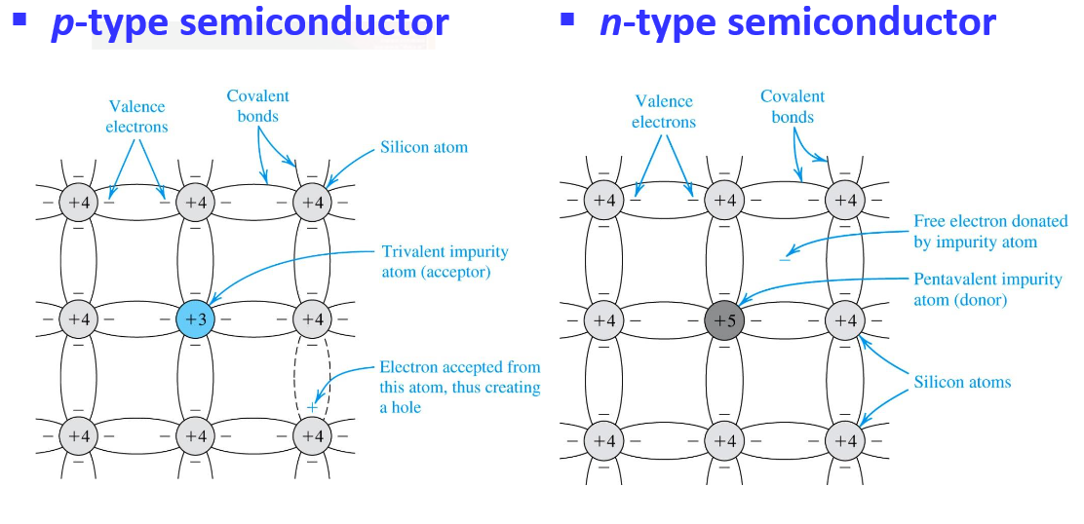
Doped Semiconductors

Slide 8
Electron and Hole Concentrations in n and p type materials
Under thermal equilibrium conditions, the product of the conduction-electron density and the hole density is ALWAYS equal to the square of n_{i}
n_{i} : The concentration of conduction electrons in intrinsic silicon
N-type material
P-type material
Number acceptor atoms
Number of free electrons in n-type
Number donor atoms

Slide 9
Doped Semiconductor
The concentration of silicon atoms in the crystal is almost 10²³/cm³
In typical semiconductor devices, the concentration of impurity atoms in the range from 10¹⁵/cm³ to 10¹⁹/cm³ atoms.
The fraction of impurity is very small, about 1 part in 10^{6.}
The metallurgical properties of the crystal are not changed perceptibly.
However, the electrical properties of the crstal are greatly changed by the impurity.

Slide 10
Electron and Hole Densities
Majority Carriers (p type) :
Minority Carriers (p type) :
Majority Carriers (n type) :
Minority Carriers (n type) :
The product of electron and hole densities is ALWAYS equal to the square of intrinsic electron density regardless of doping levels.

Slide 11
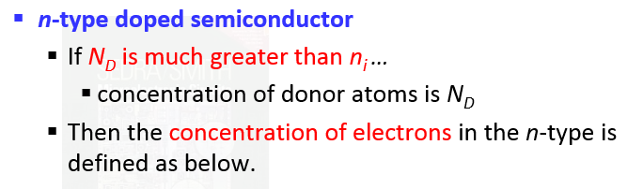
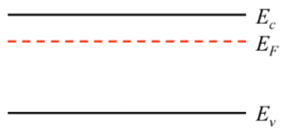
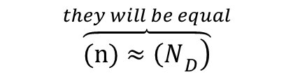
Doped Semiconductors
$$\overset{they will be equal}{\overbrace{\left.(n)≈{\left(N\right.}_{D}\right)}}$$
Number electrons in n-type
Number donor atoms

Slide 12
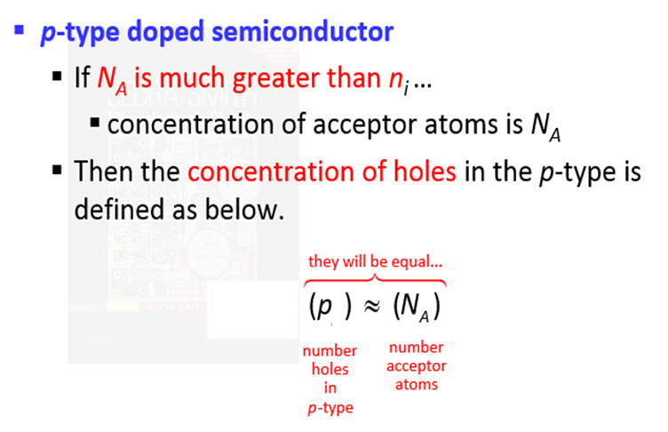
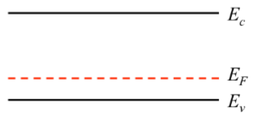
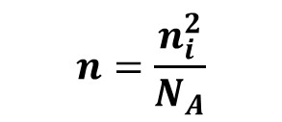
P-type Semiconductors
$$n=\frac{n_{i}^{2}}{N_{A}}$$

Slide 13
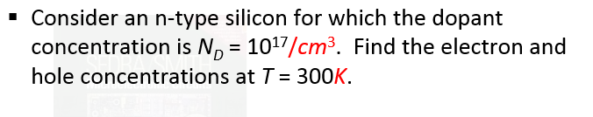
Example

Slide 14
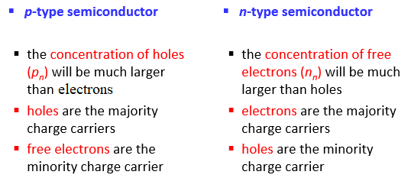
Comparision

Slide 15
Current Flow in Semiconductors
There are two mechanisms by which holes and electrons move through a crystal:
Drift Current
Diffusion Current

Slide 16
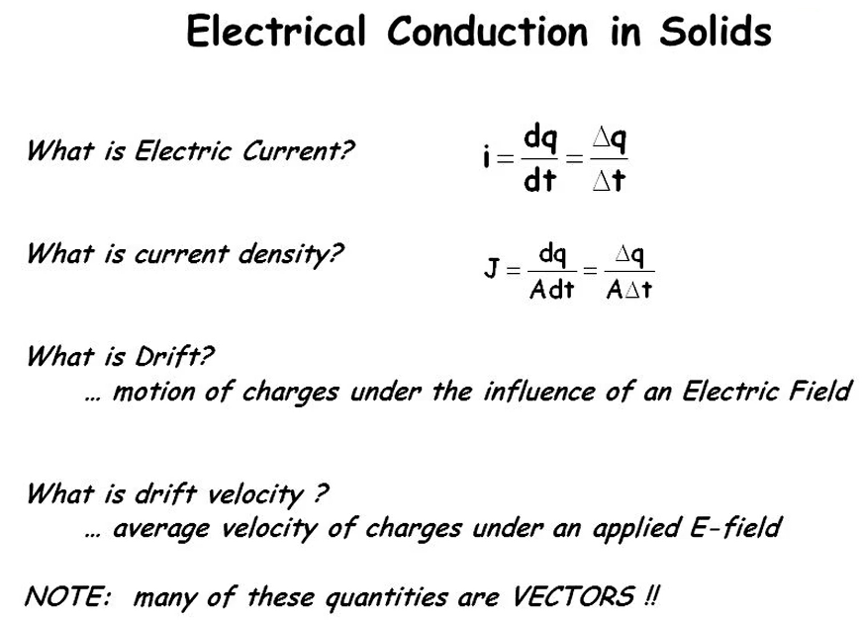
Drift Current

Slide 17
Drift current
What type of charges are responsible for current flow in conductors?
What type of charges are responsible for current flow in semiconductors?
What is mobility µ?
In solid-state physics, the electron mobility characterizes how quickly an electron can move through a metal or semiconductor, when pulled by an electric field.

Slide 18
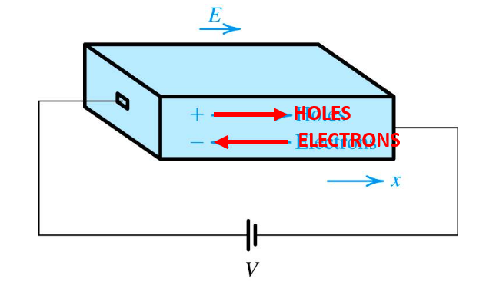
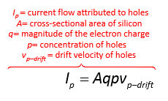
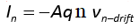
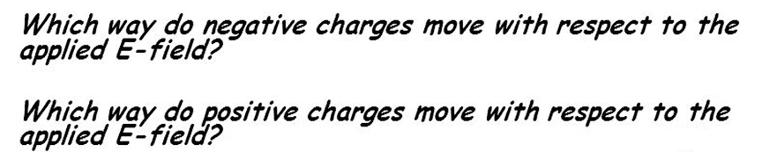
Drift Current

Slide 19
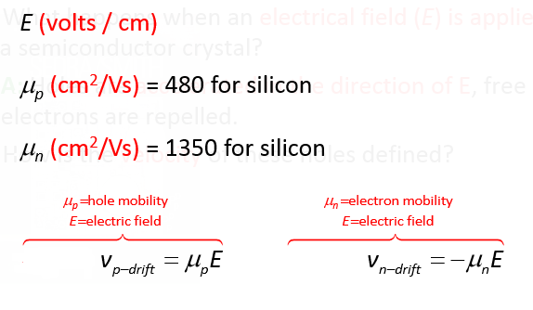
Drift current
Electrons move with velocity 2.5 times higher than holes
Drift velocity

Slide 20
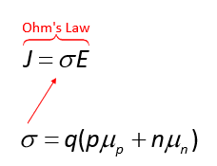
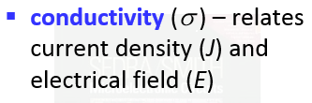
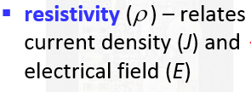
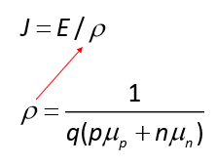
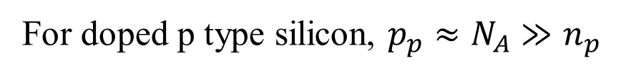
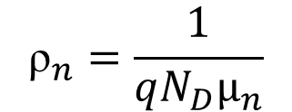
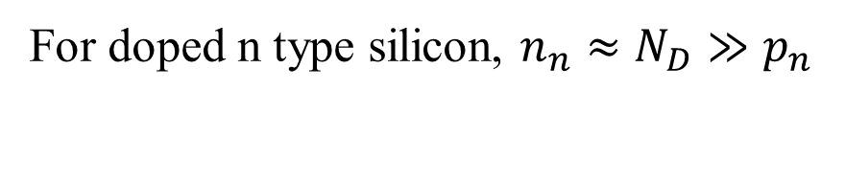
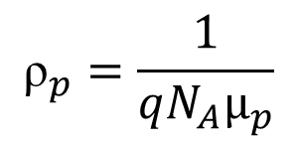
Resistivity and Conductivity of Semiconductor
For doped n type silicon, $n_{n}≈N_{D}≫p_{n}$
$${\text{ρ}}_{n}=\frac{1}{qN_{D}µ_{n}}$$
Unit: mho/cm
For doped p type silicon, $p_{p}≈N_{A}≫n_{p}$
$${\text{ρ}}_{p}=\frac{1}{qN_{A}µ_{p}}$$
Unit: ohm-cm

Slide 21
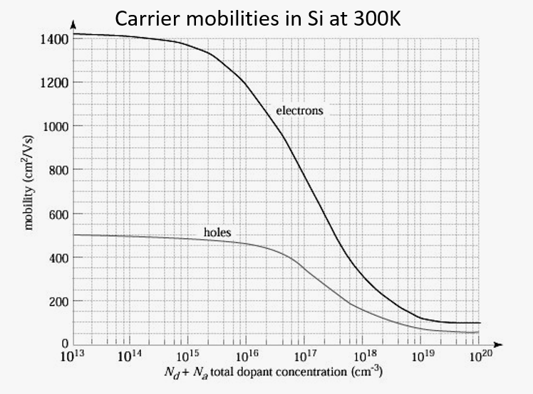
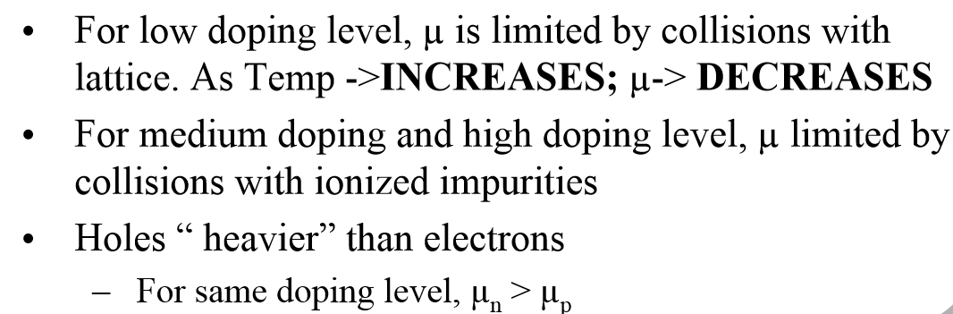

Slide 22
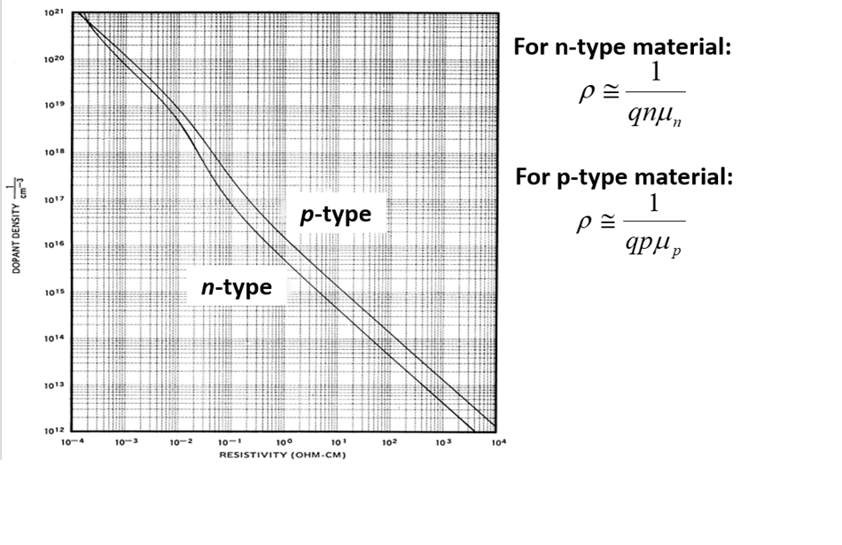
Resistivity Dependence on Doping

Slide 23
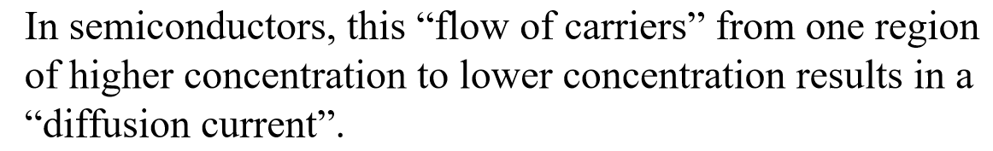
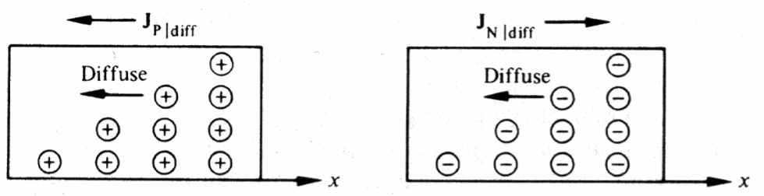
Diffusion Current

Slide 24
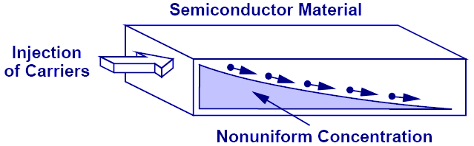
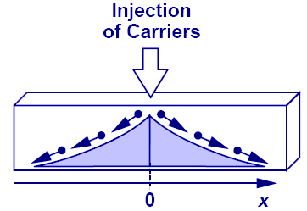
Second Charge Transportation Mechanism: Diffusion
Charge particles move from a region of high concentration to a region of low concentration. It is analogous to an every day example of an ink droplet in water.

Slide 25
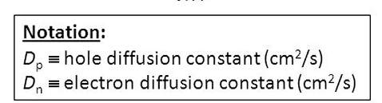
Current Flow: Diffusion
Diffusion current is proportional to the gradient of charge (dn/dx) along the direction of current flow.
Its total current density consists of both electrons and holes.

Slide 26
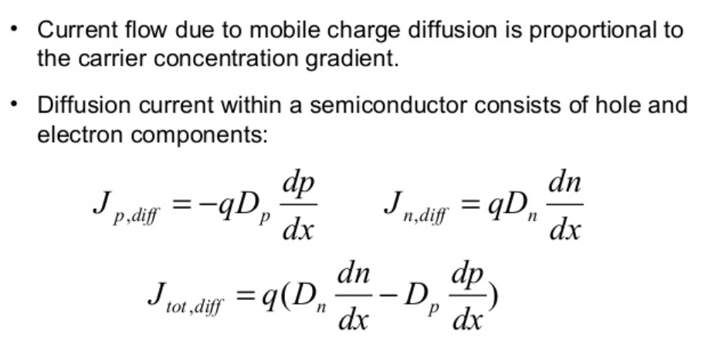
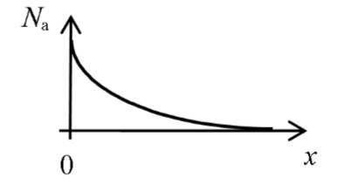
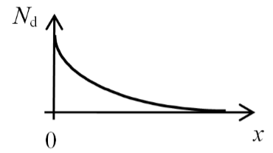
Diffusion Current
Hole direction
Current direction
The hole density varies depending on the distance
Electron direction
Current direction
The electron density varies depending on the distance.

Slide 27
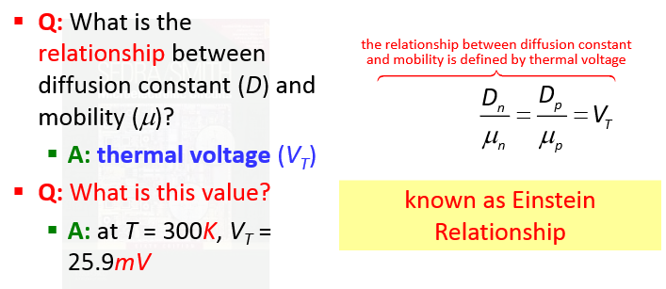
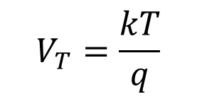
Einstein Relationship
Boltzman constant
$$V_{T}=\frac{kT}{q}$$
Magnitude of electron charge

Slide 28
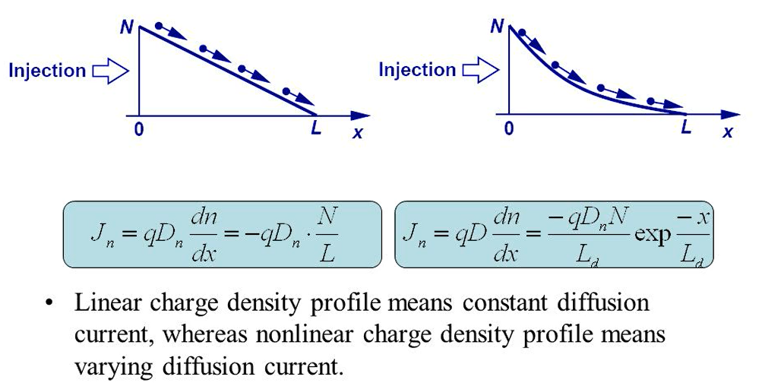
Diffusion Current

Slide 29
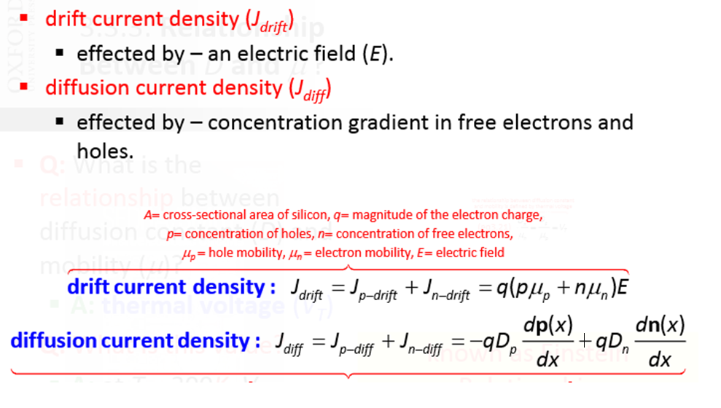
Total Current

Slide 30
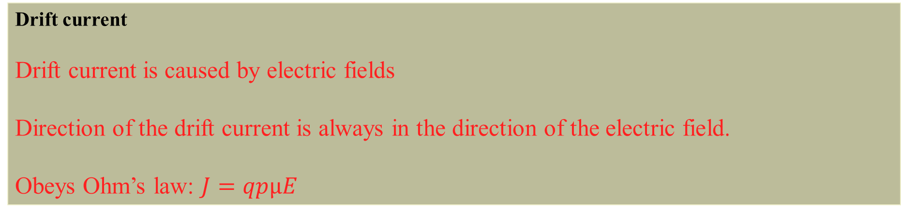
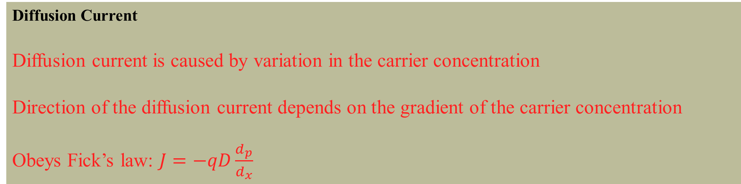
Drift current
Drift current is caused by electric fields
Direction of the drift current is always in the direction of the electric field.
Obeys Ohm’s law: $J=qpµE$
Diffusion Current
Diffusion current is caused by variation in the carrier concentration
Direction of the diffusion current depends on the gradient of the carrier concentration
Obeys Fick’s law: $J=−qD\frac{d_{p}}{d_{x}}$

Slide 31
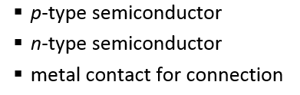
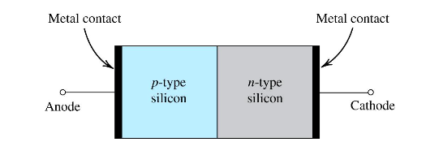
pn junction structure

Slide 32
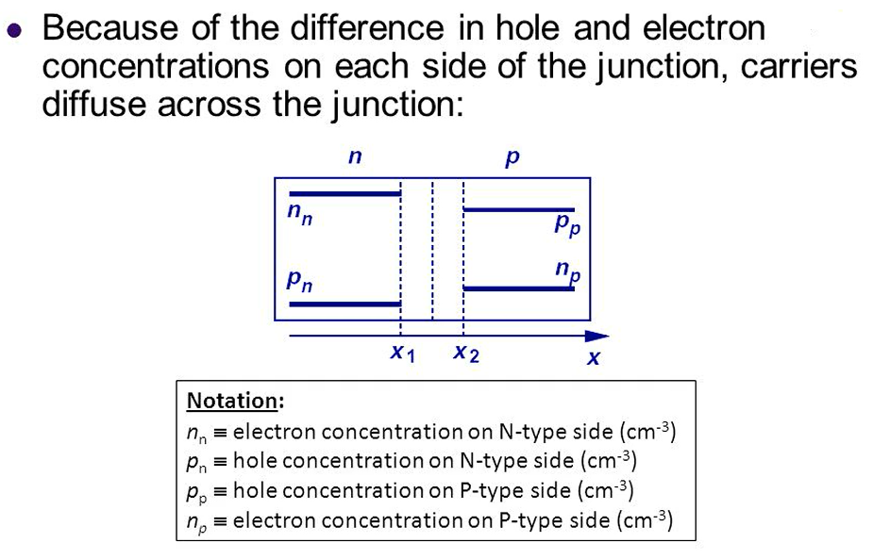

Slide 33
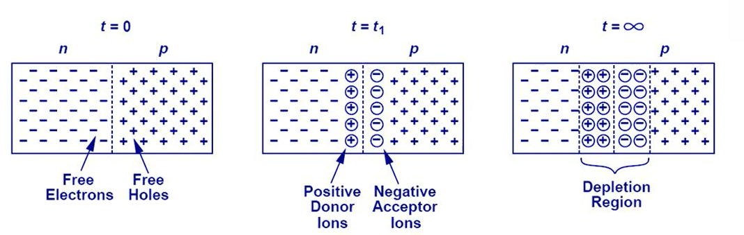
Depletion Region
PN Junction
Depletion Region
Diffusion
There is a heavy concentration of holes in the p-type region and only a light concentration of holes in the n-type region,
Holes move to from p-type into the n-type region by diffusion and they disappear by recombination very quicky.

Slide 34
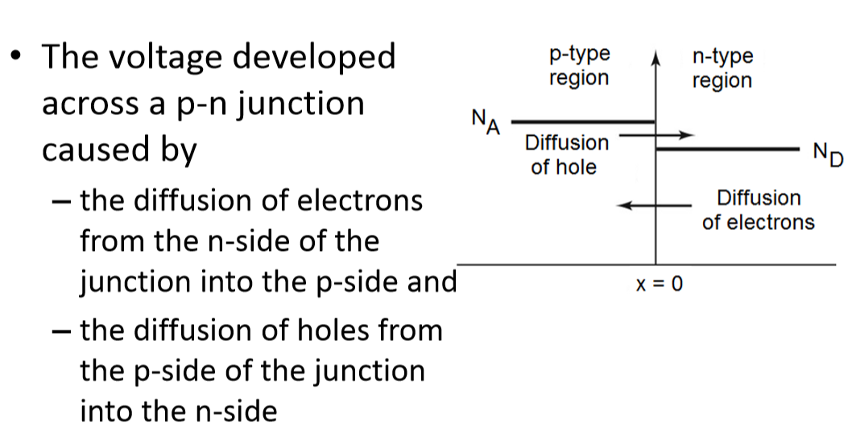
P-N Junction

Slide 35
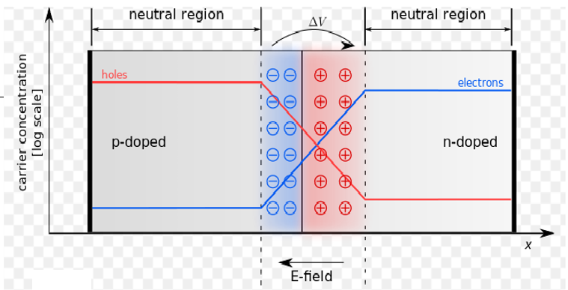
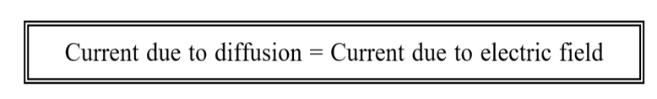
P-N Junction

Slide 36
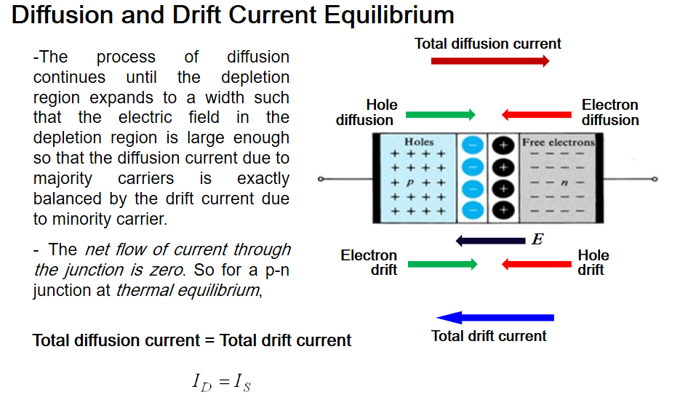

Slide 37


Depletion region

Slide 38



Slide 39


Built-in Potential
drift current
diffusion current
Number acceptor atoms
$$V_{B}=\frac{kT}{q}\ln{\frac{p_{p}}{p_{n}}},{ V}_{B}=\frac{kT}{q}\ln{\frac{N_{A}N_{D}}{{n_{i}}^{2}}}$$
Number donor atoms
Free electrons in intrinsic silicon
Barrier potential
Because of the electric field across the junction, there exists a built-in potential. Its derivation is shown above.

Slide 40





Poission equations
$$\frac{d^{2}V}{dx^{2}}=−\frac{dE}{dx}=−\frac{ρ}{ɛ}$$

Slide 41



p-n junction
Depletion region should be neutral :
W$=x_{n}+x_{p}$

Slide 42





Width of Depletion Region
$${w≈x}_{p}≈\sqrt{\frac{2ɛ_{r}ɛ_{0}V_{B}}{qN_{A}}}$$
$$N_{D}≫N_{A}$$
Distances of the depletion region on the p side
$${w≈x}_{n}≈\sqrt{\frac{2ɛ_{r}ɛ_{0}V_{B}}{qN_{D}}}$$
Distances of the depletion region on the n side
$$N_{A}≫N_{D}$$
w$=x_{n}+x_{p}$
Total width of depletion region
If impurity density is less, the thickness of the depletion layer is greater.

Slide 43

Understanding of mobility

Slide 44


Definition of Resistance
$$R=ρ\frac{L}{A}$$

